Slide 1
Inertial Measuring Unit.
Vishnu Nair
Shivam Singh
Pratik Walawalkar
Thakur College of Engineering and Technology
Internal Guide – Mrs. Archana Belge
External Guide – Mr. Ganesh Gore

Slide 2
What is Inertial Management unit (IMU)?
An electronic device that measures :-
linear acceleration
angular rate
magnetic field surrounding an object
using a combination of Accelerometer, Gyroscope, and also magnetometer.

Slide 3
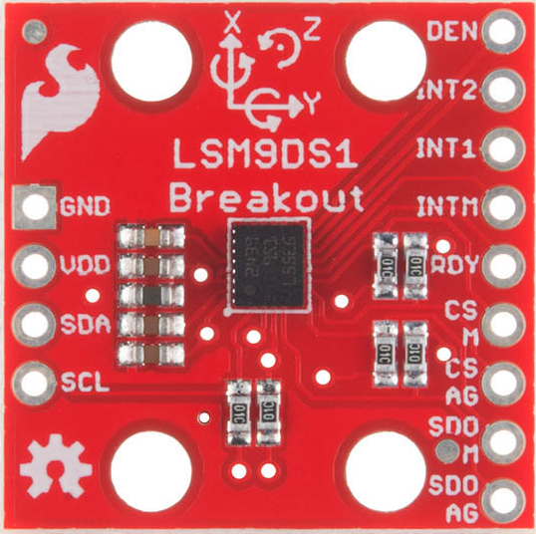
IMU we will be using - LSM9DS1

Slide 4
Motion – Sensing System-in-a-Chip LSM9DS1
Houses accelerometer, Gyroscope, Magnetometer
9 degree of freedom (DoF)
Measures angular velocity, acceleration
Supports i²C and SPI

Slide 5
Accelerometer
Used to measure acceleration of a device
A small mass is suspended by a small spring like beam which acts as a support. when acceleration is applied, a force is produced which displaces the mass from its original position
The displacement is proportional to the acceleration produced

Slide 6
Gyroscope
It works on the principle of conservation of angular momentum
Consists of a spinning wheel supported on an axis that is free to move on its own. The spinning wheel, or rotor, is mounted on a pivoting support that allows the rotation around a single axis, called a gimbal.
By using two gimbals at a time, one mounted inside the other, the gyroscope gives the rotor three degrees of rotational freedom.

Slide 7
Magnetometer
Measures magnetic field Magnetometers refer to sensors used for sensing magnetic fields OR to systems which measure magnetic field using one or more sensors.
Magnetometer measures magnetic field it is applied to and records 3 magnitude X, Y & Z
Coordinate system used is geographic (XYZ)

Slide 8
SPI Protocol
Synchronous Serial Communication
SPI works in a master slave configuration
Only one master and no. of slaves depends on chip select lines.

Slide 9
Inter integrated Chip (I²C) Protocol
The Inter-integrated Circuit (I²C) Protocol is a protocol intended to allow multiple “slave” digital integrated circuits (“chips”) to communicate with one or more “master” chips. Like the Serial Peripheral Interface (SPI), it is only intended for short distance communications within a single device. Like Asynchronous Serial Interfaces (such as RS-232 or UARTs)
Why use I²C?
Only two wires are required for communication, and by using those two wires we can connect 1008 devices
start bit and stop bits are not required for communication
data rate is greater than SPI

Slide 10
Applications
Earthquake detection
Drone Navigation
Automated Vehicle
Virtual Gaming
Automobile

Slide 11
References
www.cdn.sparkfun.com/datasheet
IEEE paper :-
RANGE SHANNON K’DOAH,MULLINS JENIFER,”BRIEF HISTORY OF GYROSCOPES", Archived from original on ,07 2015

Slide 12
Thank You

